Slide 1
Open CV
Detection of ArUco Markers

Slide 2
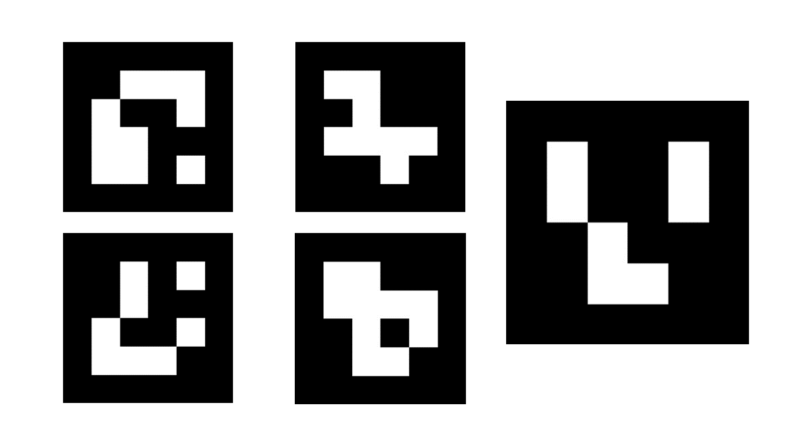
ArUco Markers
What are ArUco Markers?
Augmented Reality University of Cordoba (ArUco)
An ArUco marker is a square marker composed by a wide black border and an inner binary matrix which determines its identifier (id).
The marker resembles a QR code.
The black border facilitates its fast detection in the image and the binary codification allows its identification and the application of error detection and correction techniques.

Slide 3
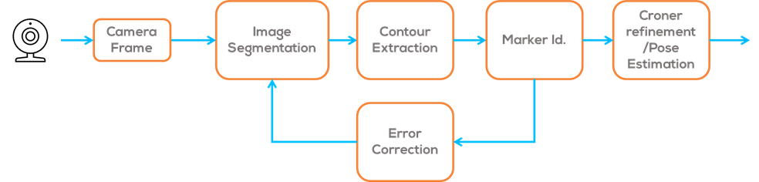
ArUco Markers
How are ArUco Markers detected?
In order to detect the coordinates of marker corners and their respective IDs, two primary steps are involved.
Firstly, potential regions for ArUco markers are identified by analysing the image and identifying square shapes that could represent markers.
Secondly, the inner binary matrix is analysed to verify it as an actual marker and compared to a reference "dictionary".
Finally, if the marker is correctly identified; a corner refinement algorithm is used to obtain the corner position and pose estimation.

Slide 4
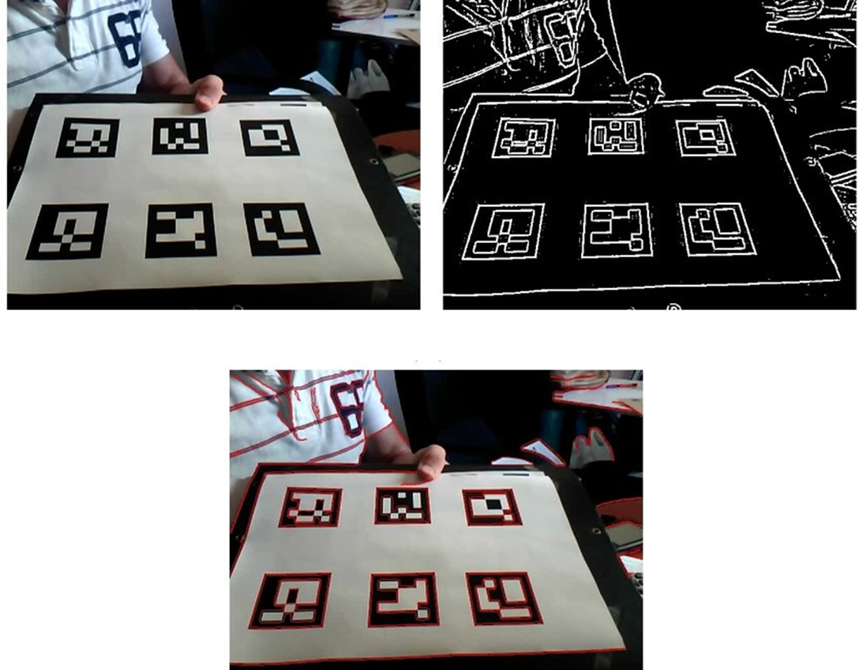
ArUco Markers
First step: Analysing regions.
This process utilises adaptive threshold binarization and computer vision techniques to segment the image, extract contours, and eliminate any shapes that are not convex or do not approximate a square.
Then, closed quadrilaterals that are not of an appropriate size are discarded, leaving only the most viable marker candidates.
Image process for automatic marker detection (a) Original Image, (b) Local threshold-ing. (c) Contour detection results
(Garrido-Jurado, S., Muñoz-Salinas, R., 2014)

Slide 5
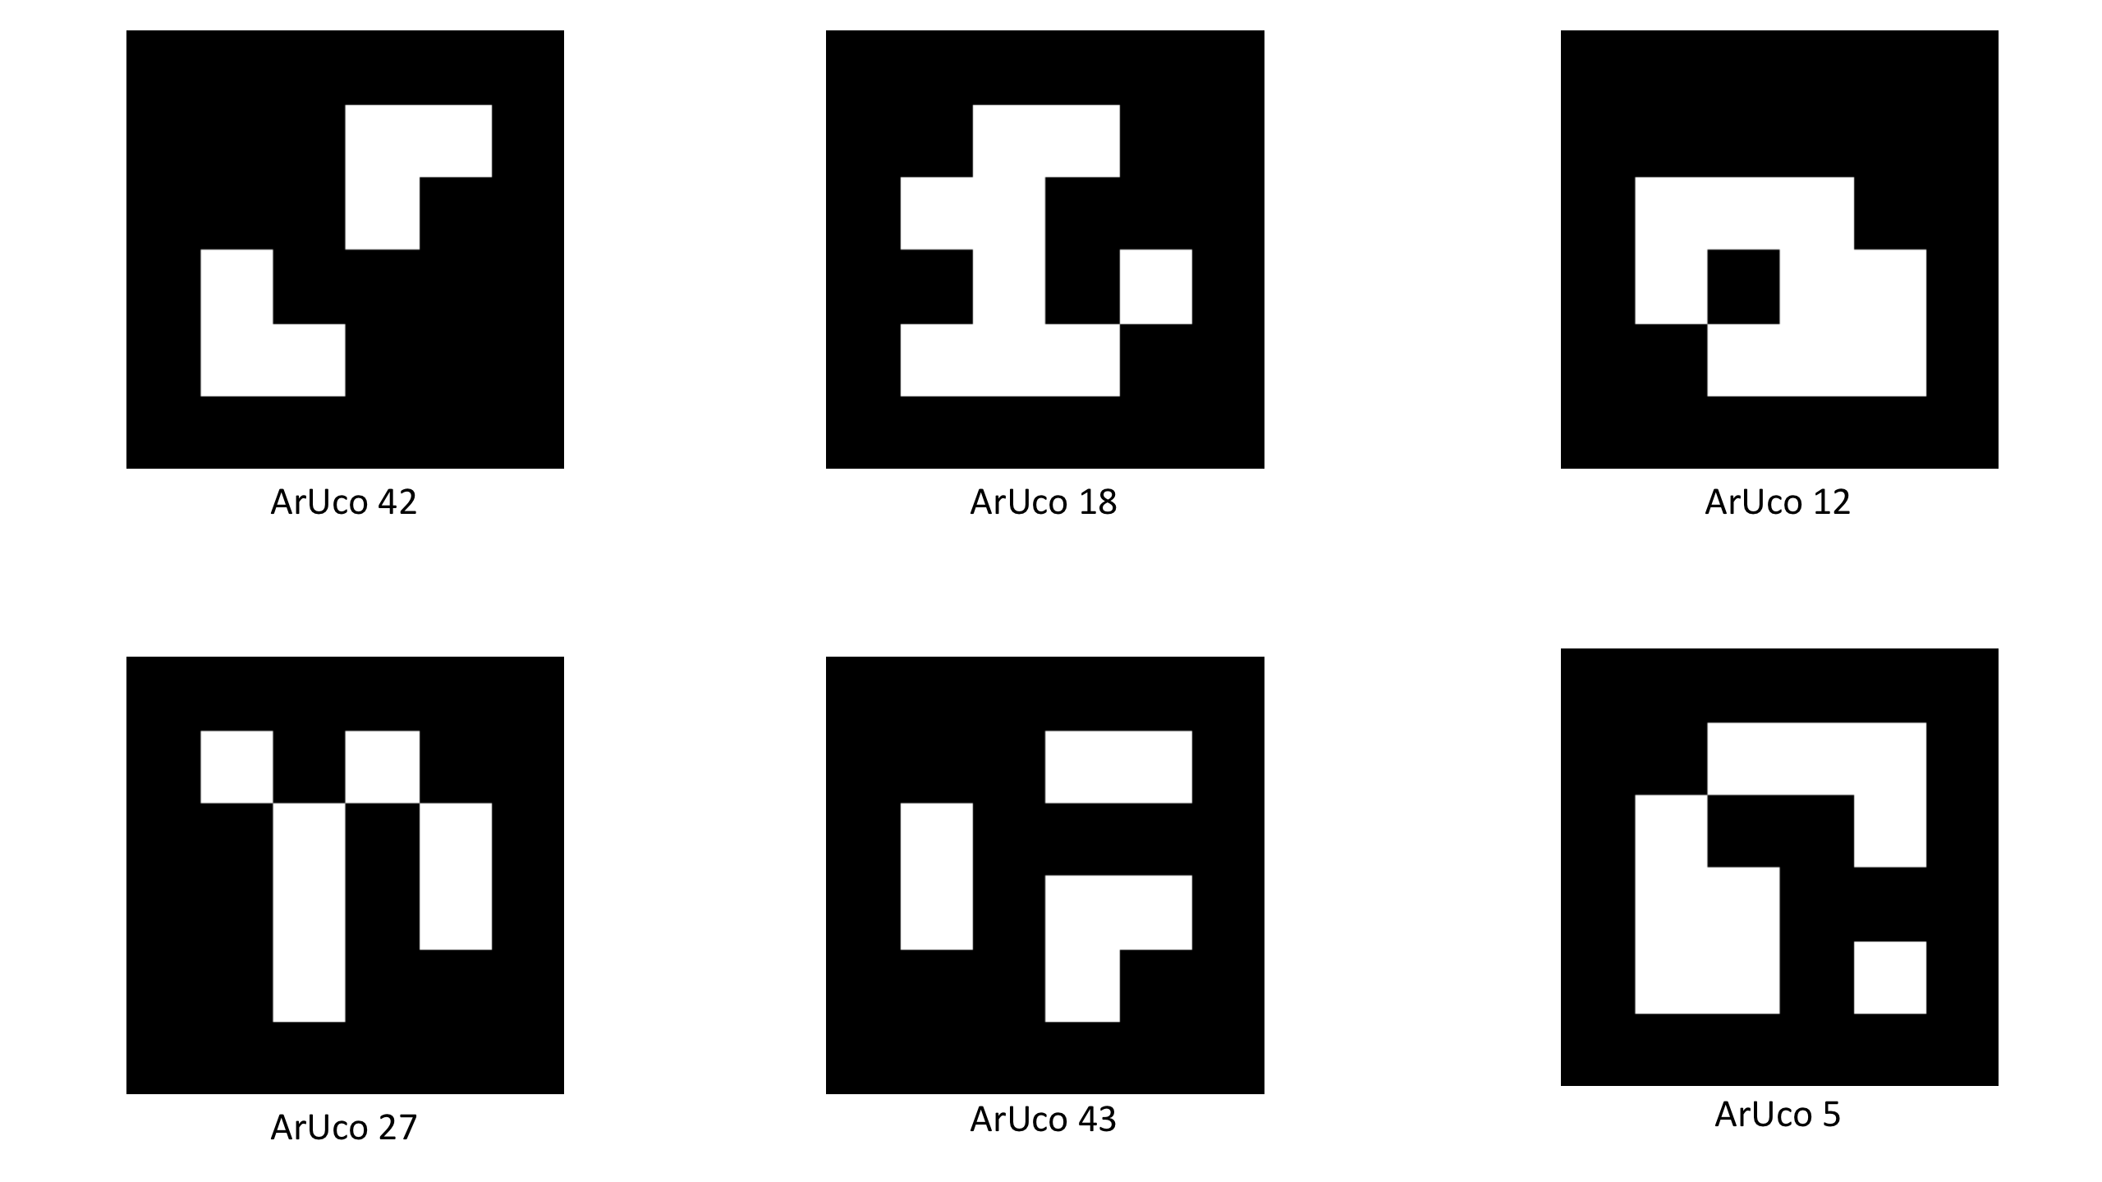
ArUco Markers
What is a dictionary?
A dictionary of markers a list of binary codifications of each of its markers.
The main properties of a dictionary are the dictionary size and the marker size.
The dictionary size is the number of markers that compose the dictionary.
The marker size is the size of those markers (the number of bits).
ArUco Library does not convert the code values to a decimal value, for efficiency purposes.
Instead, it detects the marker id simply by obtaining the marker index of the dictionary it belongs to.
ArUco Markers that belong to the dictionary class 4x4_50
4x4 (Number of bits), 50 Dictionary Size.

Slide 6
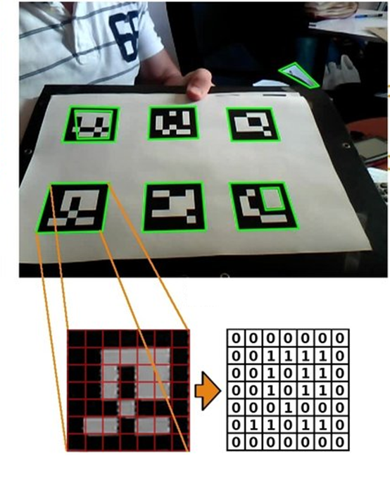
ArUco Markers
Second step: Marker Identification.
This process begins by applying a perspective transformation to obtain a square shape.
The image is then thresholded using Otsu’s method to separate the white and black parts.
The marker is divided into a grid, and the value of each element is assigned depending on the values of the majority of the pixels.
Using these values, the binary code of the candidate marker can be obtained.
Since the markers can be rotated, four sets of binary codes can be obtained, each corresponding to a different clockwise rotation order starting point.
Comparing these four binary codes with the marker dictionary, it is possible to identify the marker.
Image process for automatic marker detection (a) Perspective transformation and threshold, (b)Grid. (c) Binary code.
(Garrido-Jurado, S., Muñoz-Salinas, R., 2014)

Slide 7
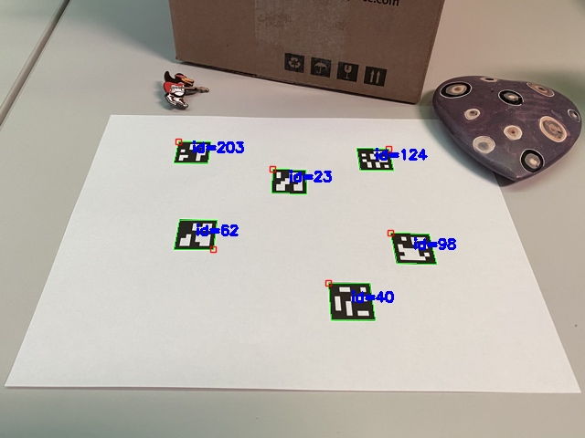
ArUco Markers
Final Step: Corner refinement and pose estimation.
If a marker is detected, its pose with respect to the camera is estimated using different algorithms.
This is known as the PnP (Perspective- n-point) problem, which is an inverse problem projection of the camera.
For some cases, a linear regression of the pixels on the side of the marker, size and shape, is used, to calculate the line intersections, obtaining its pose.
ArUco pose detection and marker Identification (OpenCV Detection of ArUco Markers Tutorial, 2023)

Slide 8
ArUco Markers
How to install the ArUco Library

Slide 9

Installing the ArUco library
On a Windows/Ubuntu computer
Install the Open CV-contrib Python library
Requirements
Python 3.x (3.4+) or Python 2.7.x from here. (ROS Melodic does not work with Python 3).
NumPy package (for example, using pip install numpy command).
Matplotlib (pip install matplotlib) (Matplotlib is optional but recommended).
Go to OpenCV Python
Follow the instructions to install the contrib-python package (Option 2)
Verify the installation on a cmd window and run the following commands
The following should appear depending on the version installed
These instructions are for installing the Open CV library on a Windows/Ubuntu machine. Not to be followed for the Jetson Nano.
More information can be found in the opencv repository here.
pip install opencv-contrib-python
python
>>>import cv2
>>>print(cv2.__version__)

Slide 10
Installing the ArUco library
On the Jetson Nano
Install the Open CV-contrib Python library using the MCR2 Jetpack image.
Warning!
There are two approaches when using ArUco Markers for the Jetson Nano.
Both work with ROS. Choose one and stick with it to prevent malfunctions.
Build OpenCV from source.
Pros: Develop everything from scratch and have better control over the program.
Cons: Develop everything from scratch. The covariance matrix of the camera must be specified (typical values between 0.01-0.03 in the diagonal zeros elsewhere)
Use ROS libraries to work with ArUco Markers.
Pros: Most things are done. The covariance matrix of the camera is calculated automatically.
Cons: Less control over the programs and resource management.

Slide 11
Installing the ArUco library (Approach 1)
Build Open CV from source
Open a terminal
Stop the Puzzlebot-ROS Service
Download the script
Go to the folder where the script is located (for this example the file is in the Downloads folder) and run it.
If permission is required change the permission using chmod +x script_name.sh
Warning: The installation can take between 2-4 hours, place the Jetson in a cool environment overheating warning!
Verify the installation on a cmd window and run the following commands
Go to the catkin_ws
Install the vision_msgs library
Update the cv_bridge package
Go to the folder /opt/ros/melodic/share/cv_bridge/cmake and open the file cv_bridgeConfig.cmake
python
>>>import cv2
>>>print(cv2.__version__)
sudo systemctl stop puzzlebot.service
cd ~/catkin_ws
install_opencv4.5.0_Jetson.sh
sudo apt install ros-melodic-vision-msgs
cd ~/Downloads
./install_opencv4.5.0_Jetson.sh
sudo apt install ros-melodic-cv-bridge
cd /opt/ros/melodic/share/cv_bridge/cmake
sudo gedit cv_bridgeConfig.cmake

Slide 12
Installing the ArUco library (Approach 1)
Build Open CV from source (continuation)
Change the line:
For the following line:
Save the file
Now you should be able to compile your packages that use OpenCV and cv_bridge.
Starting the camera on the Jetson nano
Restarting the Puzzlebot ROS service
set(_include_dirs "include;/usr/include;/usr/include/opencv")
roslaunch ros_deep_learning video_source.ros1.launch
set(_include_dirs "include;/usr/include;/usr/include/opencv4")
sudo systemctl restart puzzlebot.service

Slide 13
Installing the ArUco library (Approach 2)
Using ROS libraries to work with ArUco Markers
For this approach, the ROS Package fiducial_slam will be used.
This package provides a system that allows a robot to determine its position and orientation by looking at a number of fiducial markers (similar to QR codes) that are fixed in the environment of the robot.
More information about this package can be found here, here and here.
Note: This package depends on another ROS Package named aruco_detect package. This package handles the detection of the ArUco Markers and provides its pose w.r.t the robot’s pose.
The student can install only the aruco_detect package to obtain the same results as using the previous method of updating OpenCV and build it from source.
For this package, nor the aruco_detect, the update of the OpenCV library is not required.
The update of visions_msgs and cv_bride is required.
Open a terminal
Stop the Puzzlebot-ROS Service
Go to the catkin_ws
Install the vision_msgs library
Update the cv_bridge package
sudo systemctl stop puzzlebot.service
cd ~/catkin_ws
sudo apt install ros-melodic-vision-msgs
sudo apt install ros-melodic-cv-bridge

Slide 14
Installing the ArUco library (Approach 2)
Using ROS libraries to work with ArUco Markers (continuation).
Install the aruco_detect package.
Open a terminal
Stop the Puzzlebot-ROS Service
Go to the catkin_ws
Install the aruco_detect package
These packages, (aruco_detect and fiducial_slam) depend on other ROS packages to work. This is due to the fact that NVIDIA Jetson provides the camera image uncompressed on the topic as “video_source/raw” without any camera information (intrinsic parameters of the camera).
The aruco_detect package requires a compressed image, this can be done using the image_transport package which depends on the compressed_image_transport to compress the image. More information here and here.
Install the image_transport and the compressed_image_transport packages.
Follow steps 1-3 of the aruco_detect package
Install the image_transport and the compressed_image_transport packages.
sudo systemctl stop puzzlebot.service
cd ~/catkin_ws
sudo apt install ros-melodic-aruco-detect
sudo apt install ros-melodic-image-transport
sudo apt install ros-melodic-compressed-image-transport

Slide 15
Installing the ArUco library (Approach 2)
Using ROS libraries to work with ArUco Markers (continuation).
To compress the image please look at the examples in section 5 here.
Note: The aruco_detect package requires the intrinsic parameters of the camera to approximate the pose of the marker. These parameters are obtained using a camera calibration algorithm. It is recommended to use ROS’s camera_calibration package. More information here.
Follow steps 1-3 of the aruco_detect package
Install the camera_calibration package.
Run the camera calibration package (run NVIDIA camera node first)
Note: the camera calibration package requires a Chessboard pattern here.
The “SAVE” button will save the parameters as a YAML file.
Note: The intrinsic camera information (camera_info) is not published nor updated by the NVIDIA Jetson camera node.
The user must develop a camera information node to publish the camera parameters obtained by the calibration process.
Note: the covariance of the camera can be found in the topic
rosrun image_transport republish raw in:=/video_source/raw compressed out:=camera/image
sudo apt install ros-melodic-camera-calibration
rosrun camera_calibration cameracalibrator.py --size 9x6 --square 0.027 image:=/video_source/raw

